Slide 1
Week 7 UI/UX and everything in-between
DESN2000 SENG Workshop
SENG, T2 2026

Slide 2
Overview – UI/UX and in between
2 hour workshop
Intro
UI/UX
What to do with feedback….
Group Work – working towards getting first sprint test ready
Intro | UI/UX | Group Work | Wrap-up
5 min | 50 min | 50 min | 5 min
all | all | group | all

Slide 3
Overview – Why are we here today?
What you’ll aim for
At the end of the workshop, you should understand:
What elements make a good UI
What elements contribute to a good UX (Experience)
How you can incorporate feedback into your UI

Slide 4
UI Guidelines
50 minutes
Easy to explore and easy to use
User Control and Freedom
Consistency
Match between system and the real world
Feedback
Aesthetic and minimalist design
Recognition rather than recall
Error prevention
Error diagnosis and recovery
Help and Documentation
ACCESSIBILITY!
Intro | UI/UX | Group Work | Wrap-up
5 min | 50 min | 50 min | 5 min
all | all | group | all
Notes:
REFER TO WEEK 5 LECTURE SLIDES FOR EXAMPLES!

Slide 5
UX Considerations/Guidelines
50 minutes
Fitt’s Law
Goal-Gradient Effect
Hick’s Law
Intro | UI/UX | Group Work | Wrap-up
5 min | 50 min | 50 min | 5 min
all | all | group | all
Intro | UI/UX | Group Work | Wrap-up
5 min | 50 min | 50 min | 5 min
all | all | group | all

Slide 6
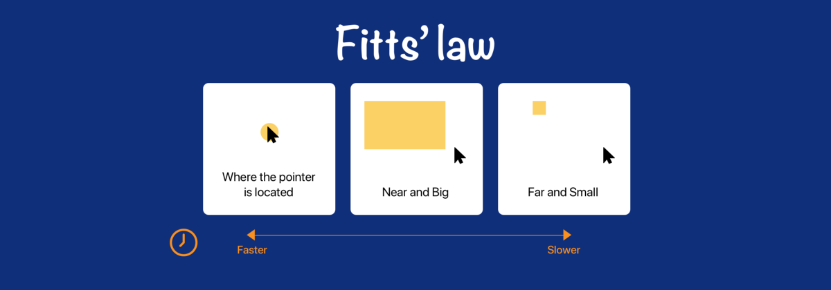
Notes:
Fitts’ law states that the amount of time required for a person to move a pointer (e.g., mouse cursor) to a target area is a function of the distance to the target divided by the size of the target. Thus, the longer the distance and the smaller the target’s size, the longer it takes.

Slide 7
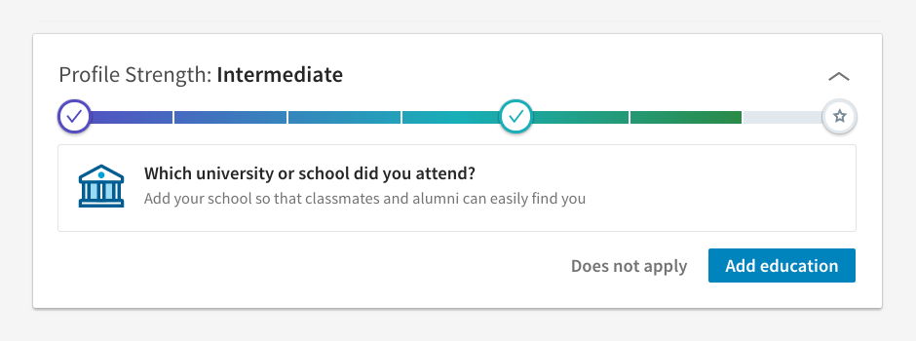

Goal Gradient Effect
Notes:
the Goal Gradient Effect states that as people get closer to a reward, they speed up their behavior to get to their goal faster. In other words, people are motivated by how much is left to reach their target, not how far they've come.

Slide 8
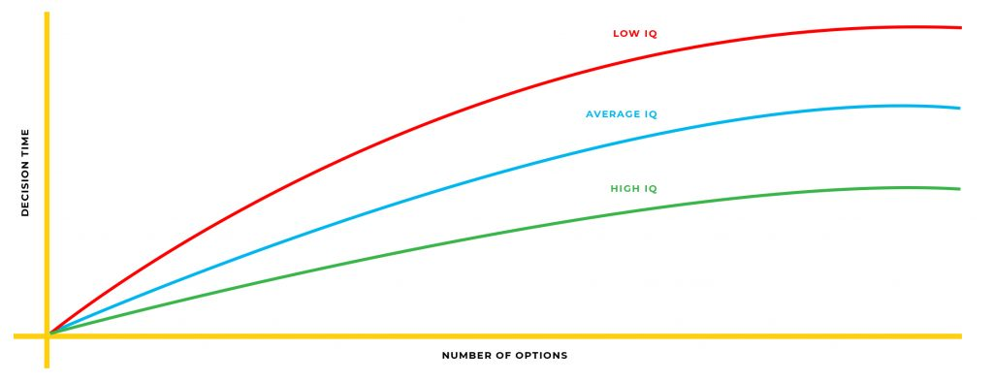
Hick’s Law
Notes:
Hick's Law is a simple idea that says that the more choices you present your users with, the longer it will take them to reach a decision. Just be sure to simplify, without removing necessary options. You can even improve user experience by making them make two very simple decisions (maybe 1/3) instead of one more difficult one (1/6).

Slide 9
Design Patterns
50 minutes
Some common patterns
Breadcrumbs
Calendar Picker
Any dark patterns!? (trick questions, hidden costs, forced continuity, etc)
Intro | UI/UX | Group Work | Wrap-up
5 min | 50 min | 50 min | 5 min
all | all | group | all
Intro | UI/UX | Group Work | Wrap-up
5 min | 50 min | 50 min | 5 min
all | all | group | all
Notes:
Breadcrumbs on the next page, Calendar picker is obvious, hidden costs and trick questions are always implemented on budget airline websites such as Jetstar to trick people into spending extra money on minor upgrades such as luggage, seat selection, food and even car hire. This is also common in insurance and more.

Slide 10


Breadcrumbs

Slide 11
UI/UX
50 minutes
Now let’s consider three financial platforms (you can choose any three that you like!)
First of all – what is the goal of each interface and what is the context of use?
Based on the goals and context of use:
For each interface, take some screenshots and analyse to find:
An example of a positive and negative of each of the UI guidelines
An example of a positive and negative UX Consideration
An example of one positive and one negative design pattern
Are there any aspects you would change in the interface? Why?
Notes:
Encourage them to choose one or two which offer similar services to which they plan to provide. Then one which is quite different, but relevant to get diversity of inspiration.

Slide 12
UI/UX Incorporating feedback
50 minutes
Rate each issue as a bug that you encounter
Is it cosmetic only?
Does it hinder a person’s interaction with the system?
Is it bad navigation?
How does it affect the overall experience?
What is the frequency of the issue? Does only one person have the problem, or is it every person?
Once you rank the issues, you are ready to start making fixes
Notes:
Some bits of feedback will not be said verbally, but may be a cue for you to observe such as hesitation on where to go next highlighting potential bad navigation.

Slide 13
Group Work
50 minutes
This is now your group work time where you can work in your group on your project deliverables
What should we be doing?
Work through your first sprint prototype to prepare it for testing (what UI and UX elements are you bringing into your prototypes?), make sure all acceptance criteria make sense and allows you to check the navigation/flow make sense
Your demonstrator will walk around and check in with each group to provide feedback on your progress and answer any questions you may have
Intro | UI/UX | Group Work | Wrap-up
5 min | 50 min | 50 min | 5 min
all | all | group | all

Slide 14
Group Work
50 minutes
Each week we will check in on where we are at with our projects to make sure that everyone is moving towards the same goals.
Week 1
Week 2
Week 3
Week 4
Week 5
Week 6
Week 7
Week 8
Week 9
Week 10
Week 11
Interim Report
Prelim Report
Design Presentation
Final Report
What is my problem?
What about a potential solution?
Envisage the solution
Test and Iterate
Did you consider accessibility?
Who is my user?
What do my users want?
Test and Iterate
User Stories
Document and present
Test and Iterate

Slide 15
Next week
Accessibility
Designing for all users
Principles and considerations

Slide 16
Wrap
5 minutes
Reflection: Why is it important to think about UI components and design the User Experience well?
Intro | UI/UX | Group Work | Wrap-up
5 min | 50 min | 50 min | 5 min
all | all | group | all

